Slide 1
Social dialogue in Norway and KS’ role as an employer organisation in negotiating collective agreements
Special advisor Alexander Henriksen, KS Negotiations
«En selvstendig og nyskapende kommunesektor»

Slide 2
KS - Employer organisation and Central collective negotiation body
Central negotiating body on behalf of 366 local and regional authorities
All the members (municipalities, counties, enterprises) have assigned KS the right to negotiate and with binding effect enter into collective agreements on salary and employment terms for the employees in the municipalities/regions.
Municipal sector:
Approx. 500.000 employees – 30% of the workforce
Total salary mas: 280 billion NOK

Slide 3
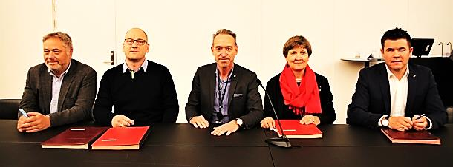
The confederations of labour unions
Counterparts:
4 confederations of labour unions, representing 40 different national unions of employees

Slide 4
Two agreements
Basic Agreement (The “constitution” of the Social Dialogue)
The negotiation system
Cooperation and relations between employers and employees
Basic Tariff Agreement
Wage and general employment terms (pay during sickness, maternity leave, working hours, holiday, etc.), pensions
A minimum wage agreement, local freedom to pay more
And additionaly: 25 «special agreements»

Slide 5
What are the characteristics of social dialogue in Norway?
large degree of trust between the social partners
predictable relations
a willingness to find solutions
strong relations between both:
central trade unions and employer organizations
local trade unions and the municipalities/regions/enterprises.

Slide 6
The «Norwegian model»
A century of collective bargaining and organised interest representation in political arenas has resulted in:
Universal welfare arrangements and a large public sector
High employment among both men and women
Small wage differences and a large degree of social mobility
Strong collective actors
Centrally co-ordinated wage formation and local bargaining at the company level
Close co-operation between the government, employers’ associations and trade unions as well as strong co-determination and particpation at the company level

Slide 7
KS Negotiations

